Slide 1
Chapter 7
The Design of Digital Systems

Slide 2
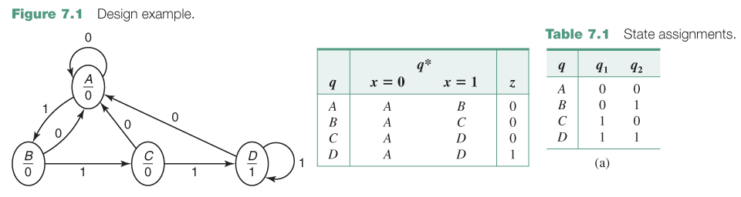
1. Create a state table for the state diagram above.
2. Create a “Design Truth Table” (x,q₁,q₂,q₁*,q₂*)
3. Create a Karnaugh Map for q₁* and q₂* and z.

Slide 3
Flip-Flops - Next State Equations
RS-Flip Flops (Set-Reset)
  q* = S + R’q
D-Flip Flops (Delay)
  q* = D
T-Flip Flops (Toggle)
  q* = T + q
JK-Flip Flops (JK)
  q* = Jq’ + K’q
S
R
q
q’
D
q
q’
T
q
q’
J
K
q
q’
Clock

Slide 4
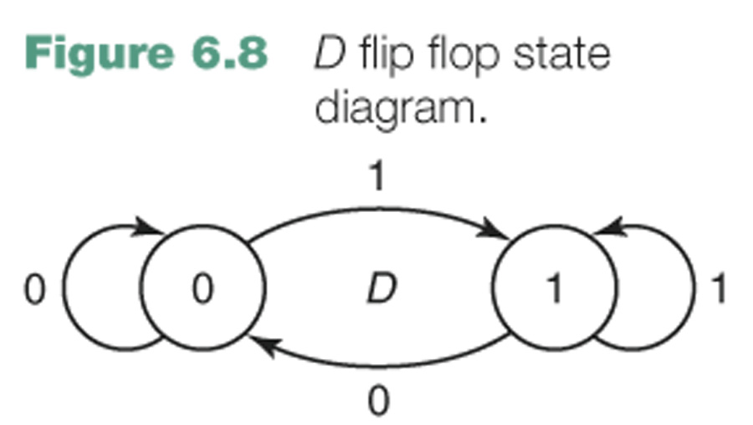
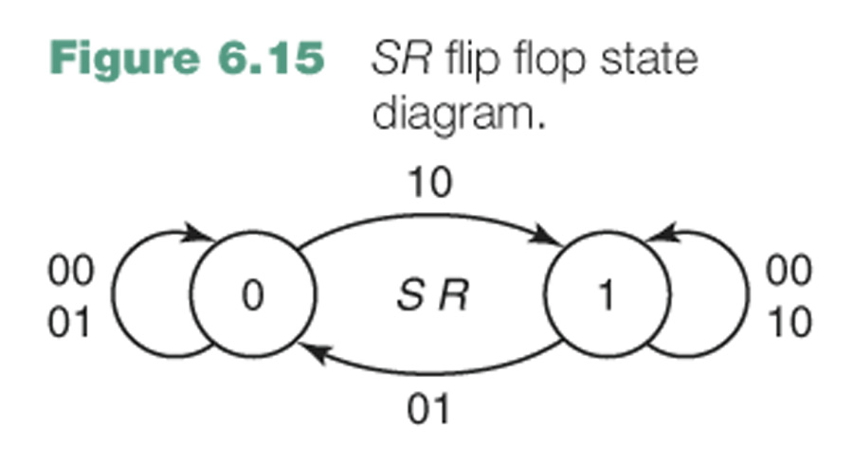
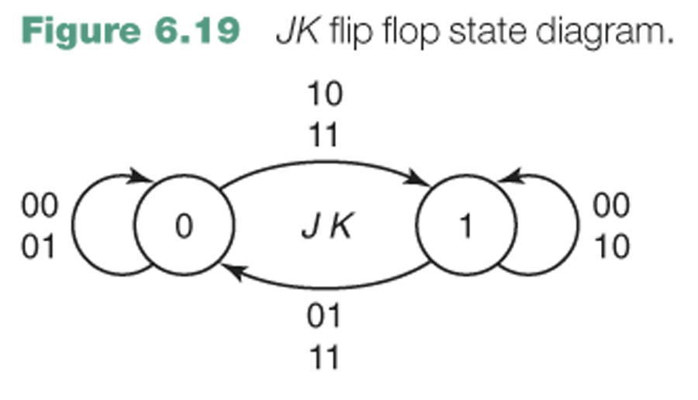
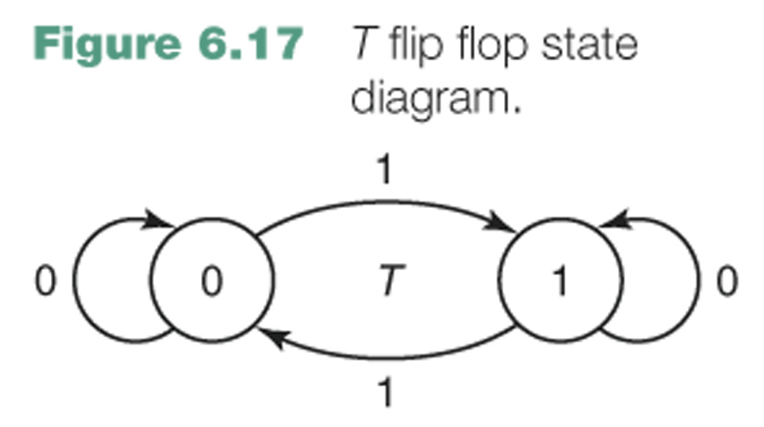

Slide 5
Design a Moore system with one input x and one output z, the output of which is 1 iff three consecutive 0 inputs occurred more recently than three consecutive 1 inputs.

Slide 6
Answering Machine
Inputs
R = Ring (during a clock cycle)
N = 0 to answer after 2 ring, 1 for 4 rings
Output
Z = Start recorder

Slide 7
Answering Machine - Phase Two
Inputs
R = Ring (during a clock cycle)
A = Answered (Receiver up or down)
N = 0 to answer after 2 ring, 1 for 4 rings
Output
Z = Start recorder

Slide 8
Continuing Examples (CE)
CE7. A Mealy system with one input x and one output z such that z = 1 at a clock time iff x is currently 1 and was also 1 at the previous two clock times.
CE8. A Moore system with one input x and one output z, the output of which is
1iff three consecutive 0 inputs occurred more recently than three consecutive 1 inputs.
CE9. A system with no inputs and three outputs, that represent a number from 0 to 7, such that the outputs cycles through the sequence 0 3 2 4 1 5 7 and repeat on consecutive clock inputs.
CE10. A system with two inputs, x₁ and x₂, and three outputs, z₁, z₂, and z₃, that represent a number from 0 to 7, such that the output counts up if x₁ = 0 and down if x₁ = 1, and recycles if x₂ = 0 and saturates if x₂ = 1. Thus, the following output sequences might be seen
x₁ = 0, x₂ = 0: 0 1 2 3 4 5 6 7 0 1 2 3 4 5 6 7 . . .
x₁ = 0, x₂ = 1: 0 1 2 3 4 5 6 7 7 7 7 7 7 7 7 7 . . .
x₁ = 1, x₂ = 0: 7 6 5 4 3 2 1 0 7 6 5 4 3 2 1 0 . . .
x₁ = 1, x₂ = 1: 7 6 5 4 3 2 1 0 0 0 0 0 0 0 0 0 . . .
(Of course, x₁ and x₂ may change at some point so that the output would switch from one sequence to another.)

Slide 9
Step 1: From a word description, determine what needs to be stored in memory, that is, what are the possible states.
Step 2: If necessary, code the inputs and outputs in binary.
Step 3: Derive a state table or state diagram to describe the behavior of the system.
Step 4: Use state reduction techniques (see Chapter 7) to find a state table that produces the same input/output behavior, but has fewer states.
Step 5: Choose a state assignment, that is, code the states in binary.
Step 6: Choose a flip flop type and derive the flip flop input maps or tables.
Step 7: Produce the logic equation and draw a block diagram (as in the case of combinational systems).

Slide 10
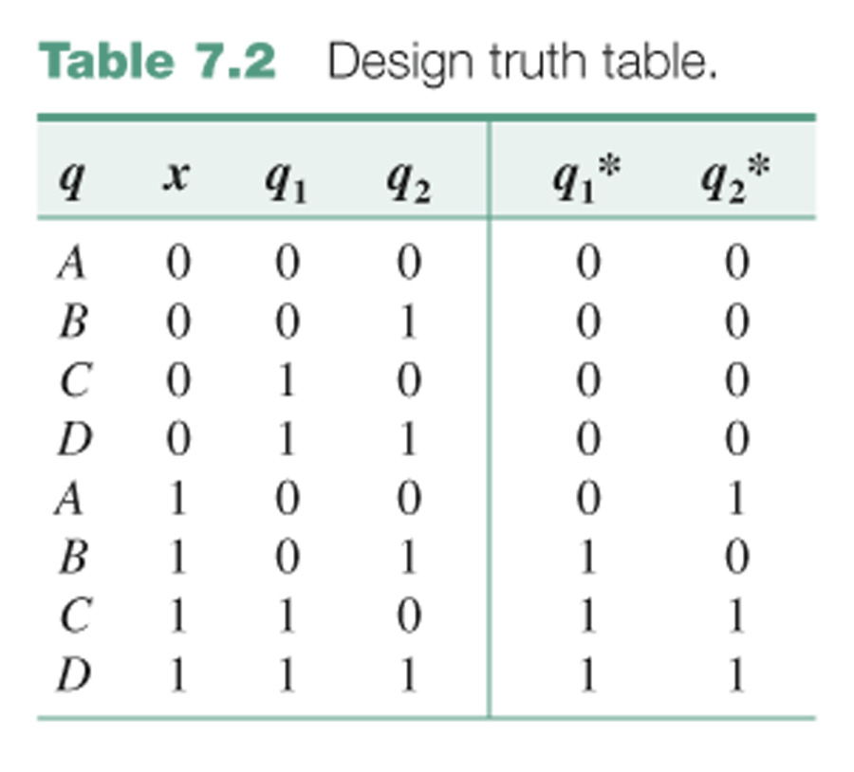
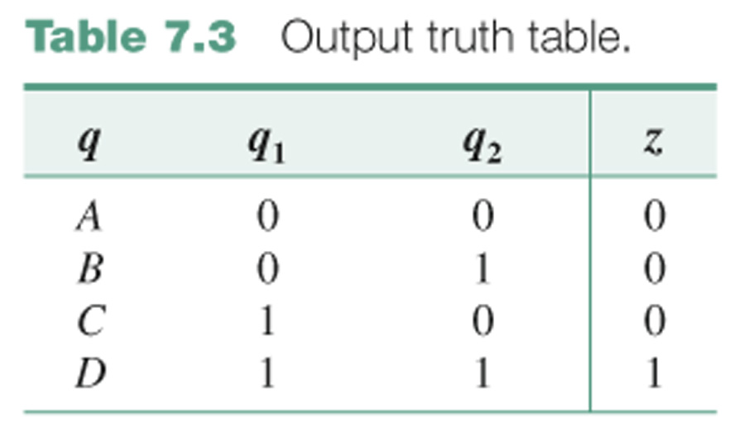

Slide 11
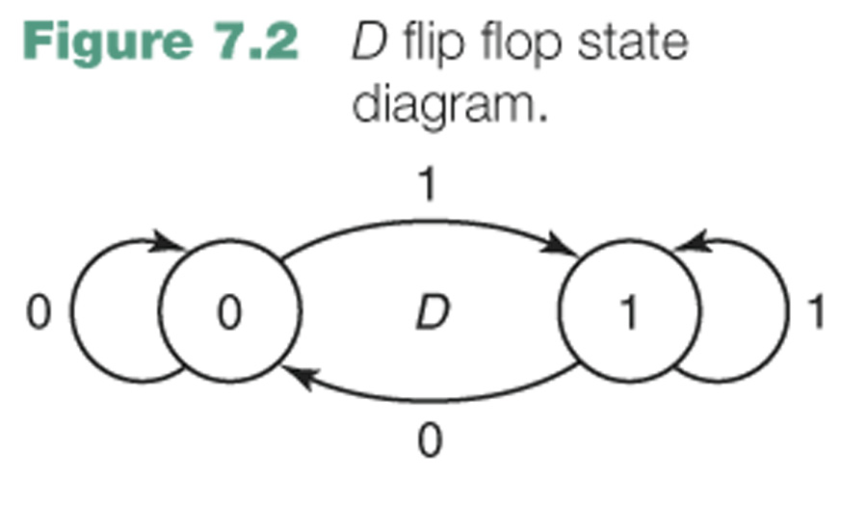
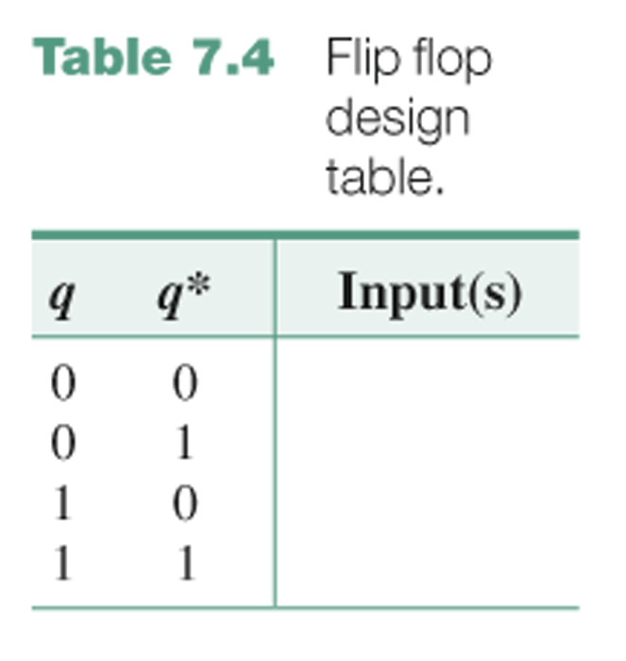
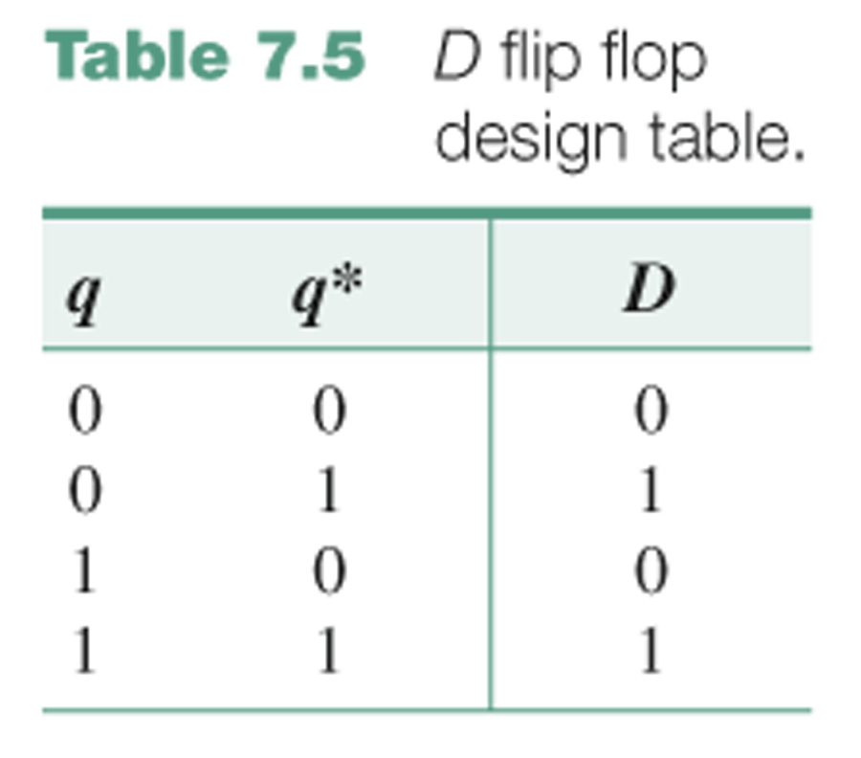
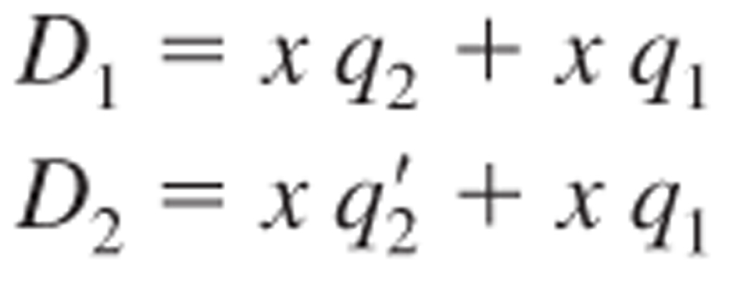

Slide 12
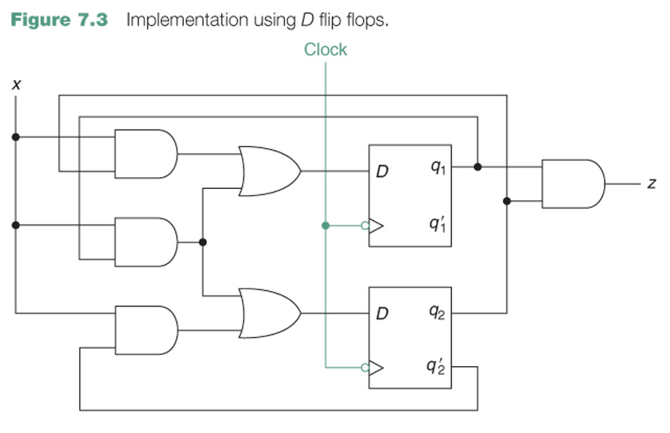

Slide 13
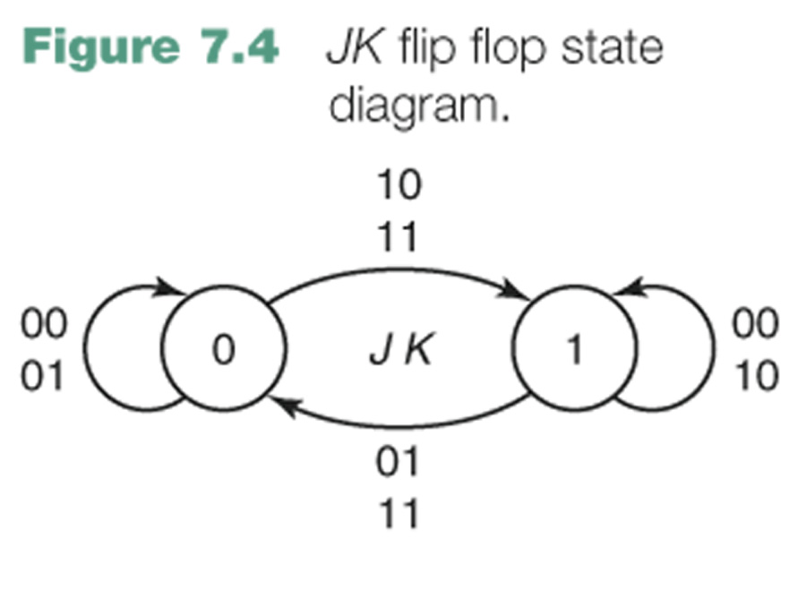
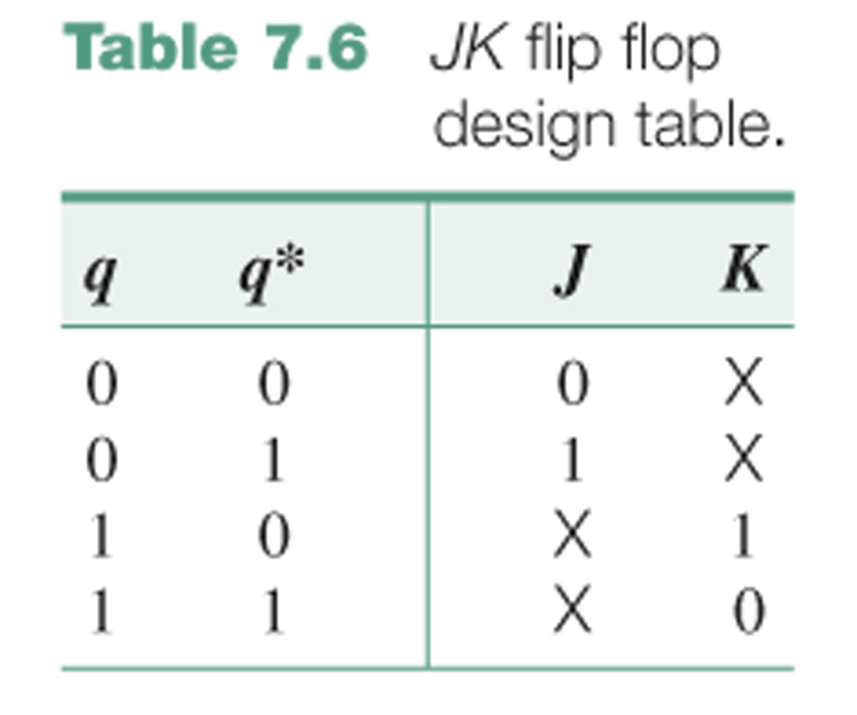
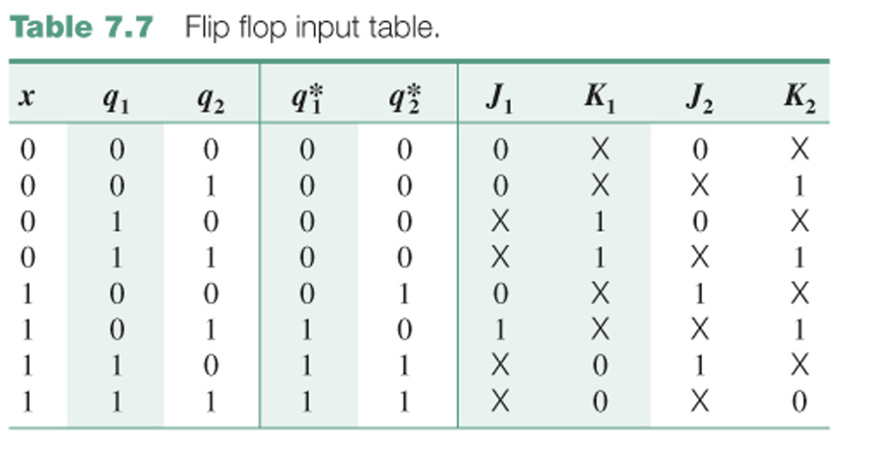

Slide 14
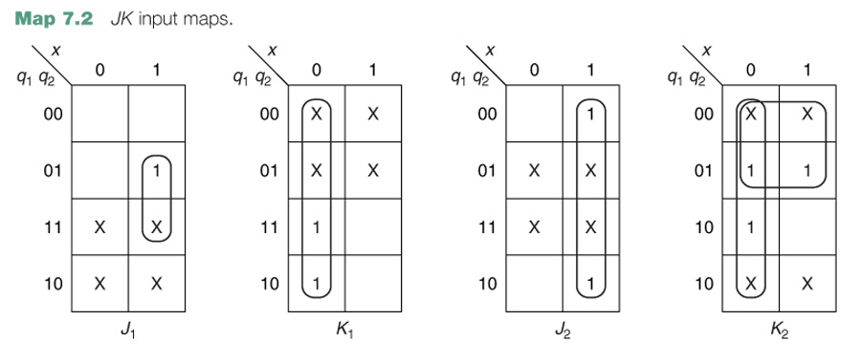
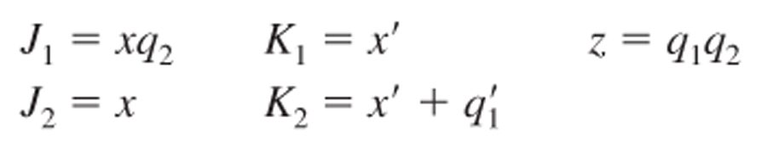

Slide 15
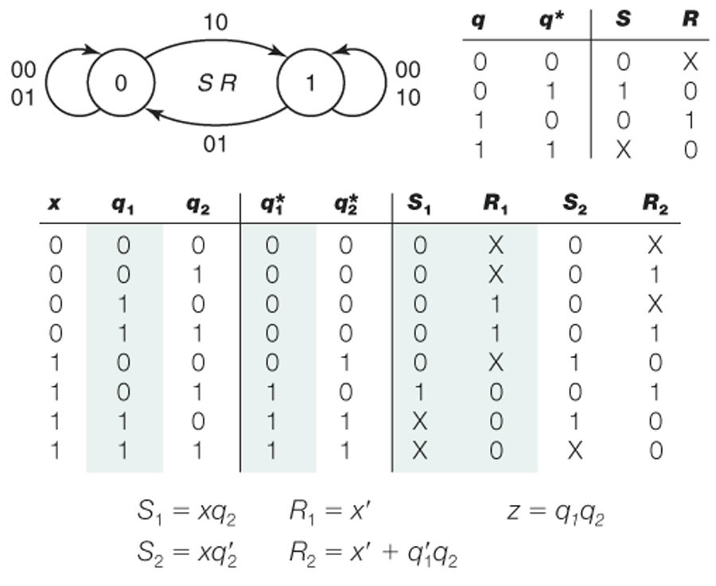

Slide 16
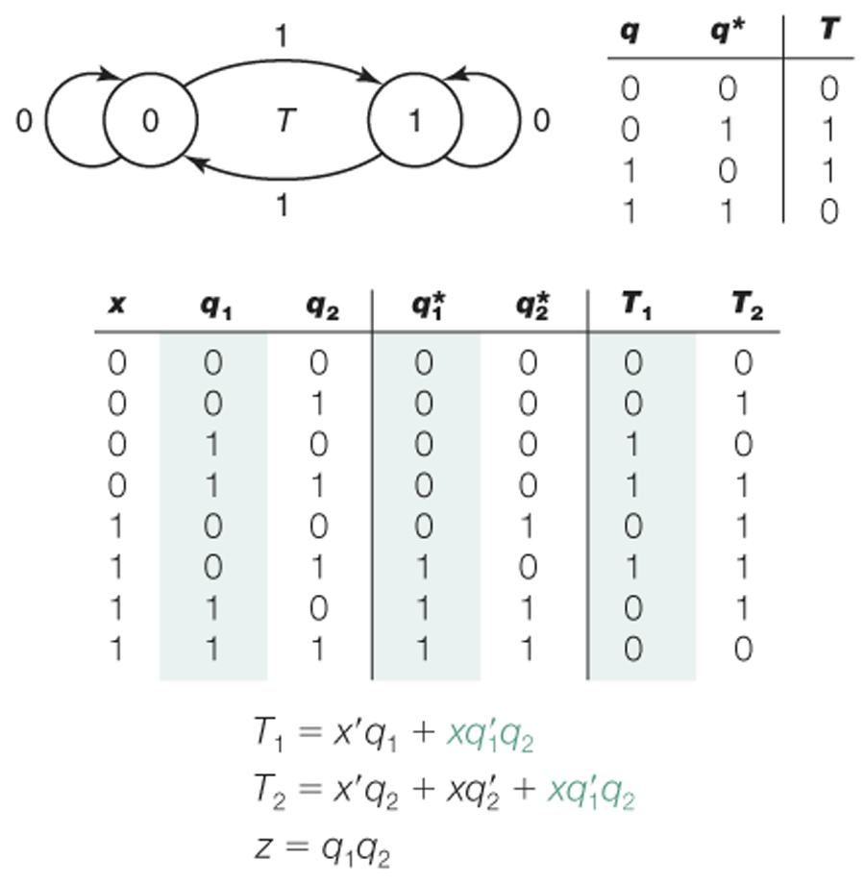

Slide 17
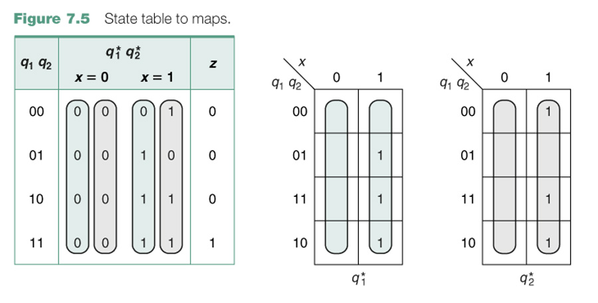

Slide 18
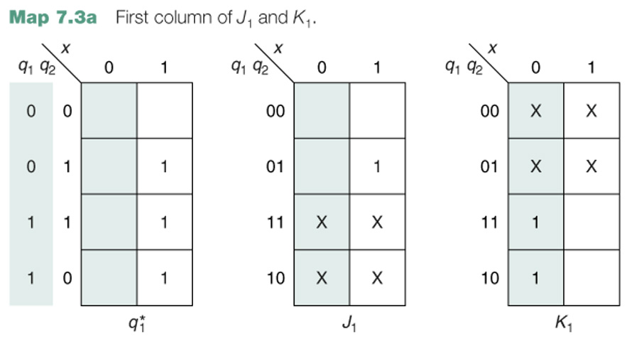
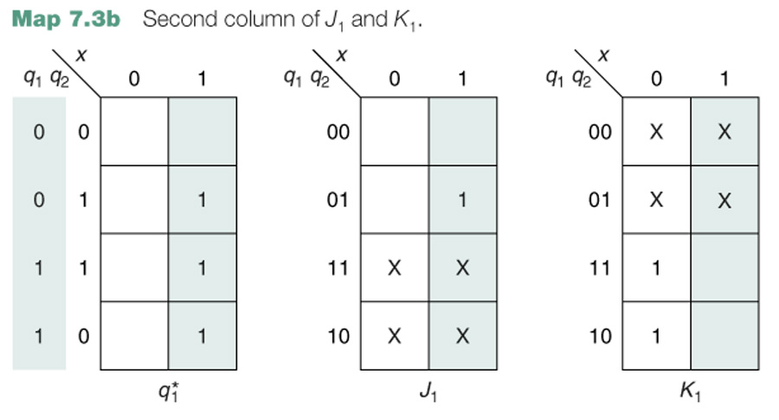

Slide 19
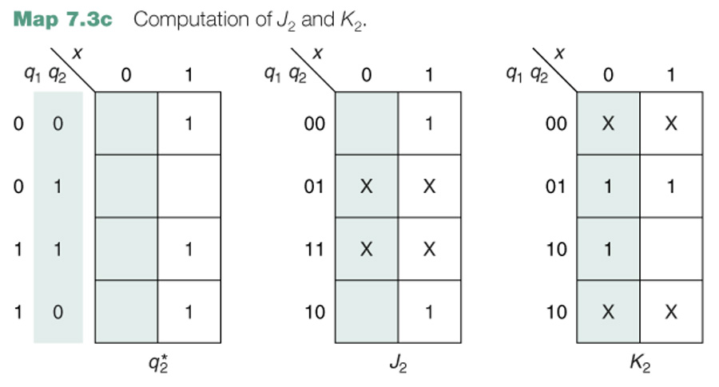

Slide 20
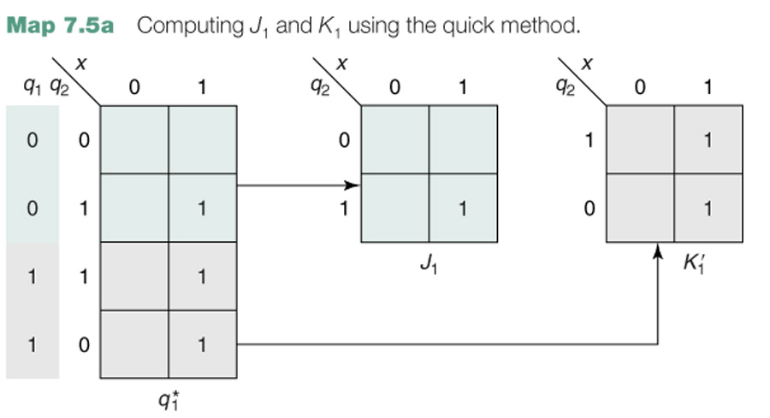

Slide 21
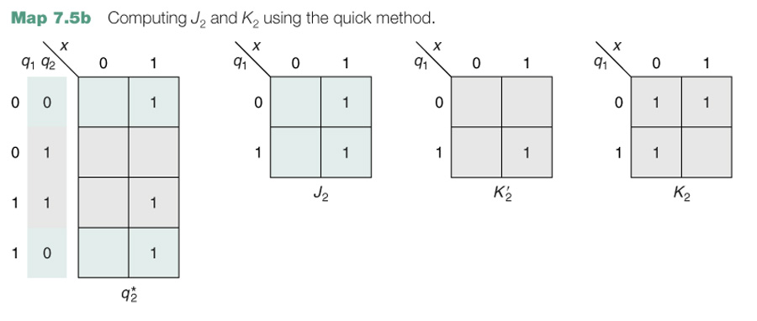

Slide 22
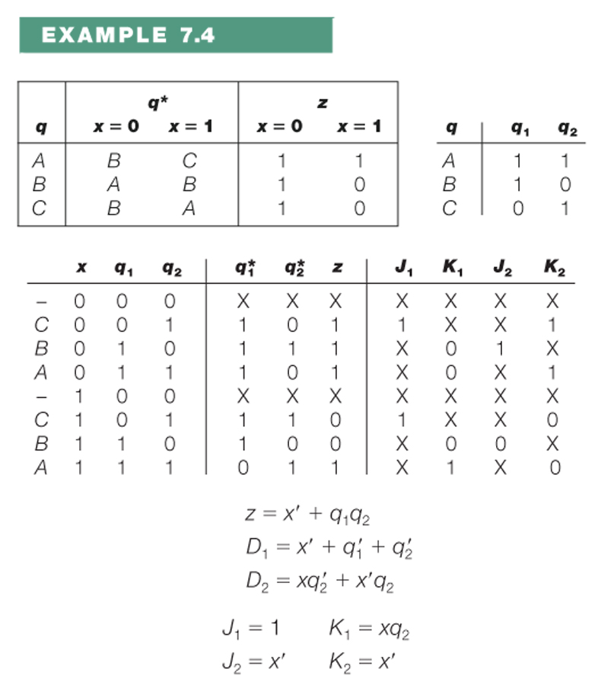

Slide 23
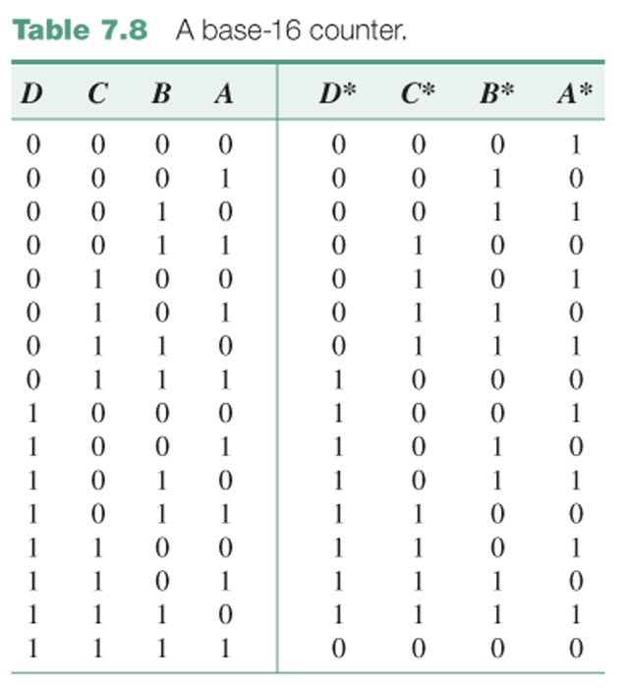

Slide 24
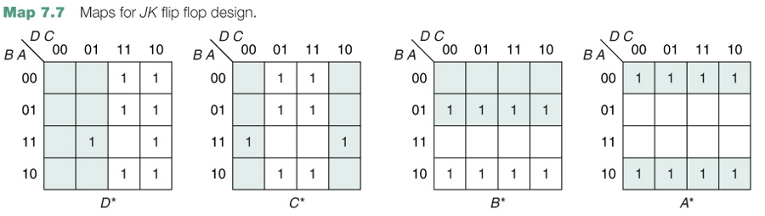
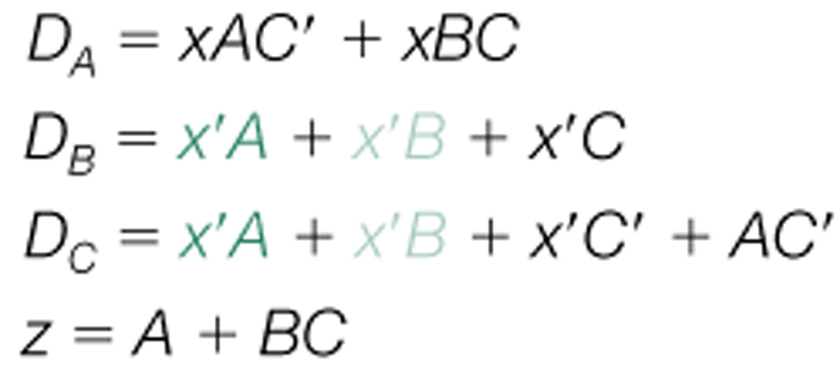
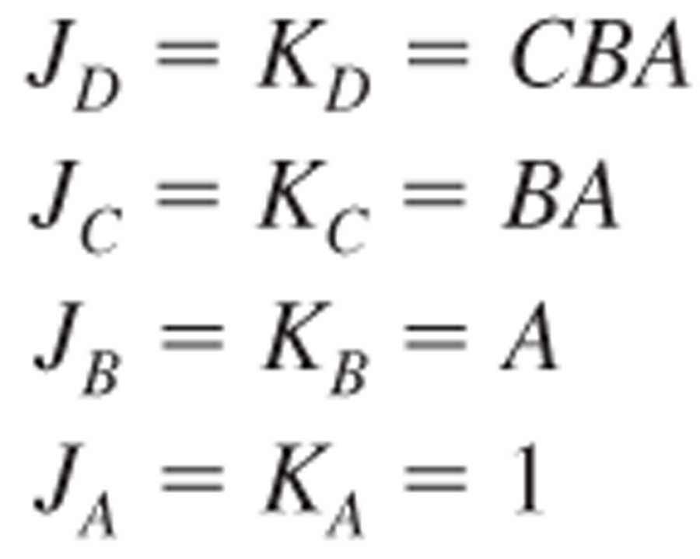

Slide 25
J_{A} = K_{A} = 1
J_{B} = K_{B} = x′A + xA′
J_{C} = K_{C} = x′BA + xB′A′

Slide 26
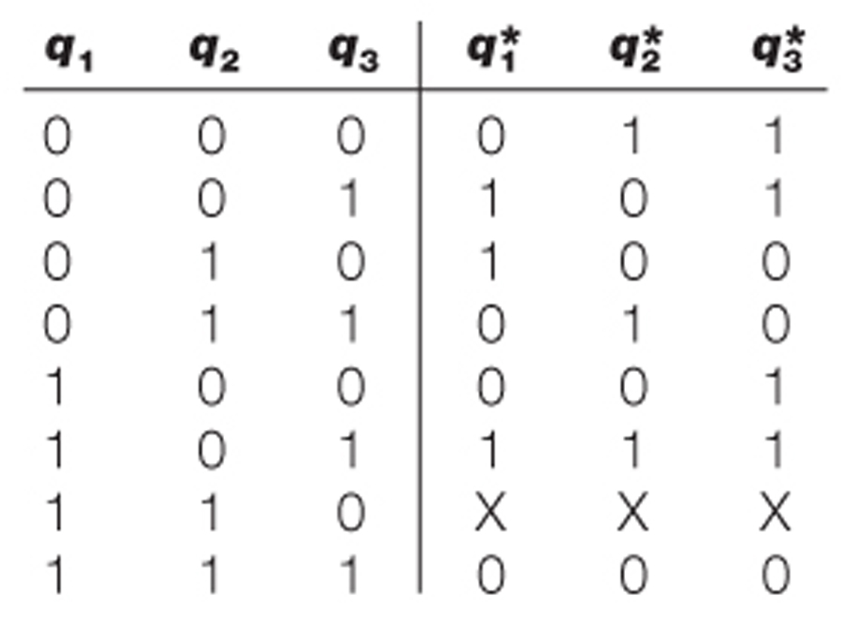
0, 3, 2, 4, 1, 5, 7, and repeat

Slide 27
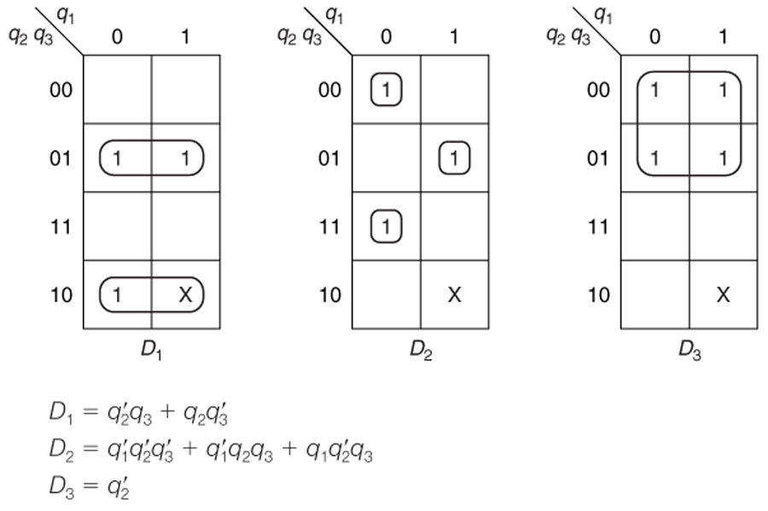

Slide 28
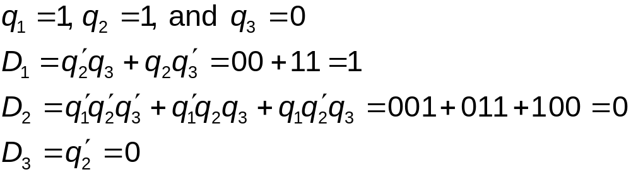
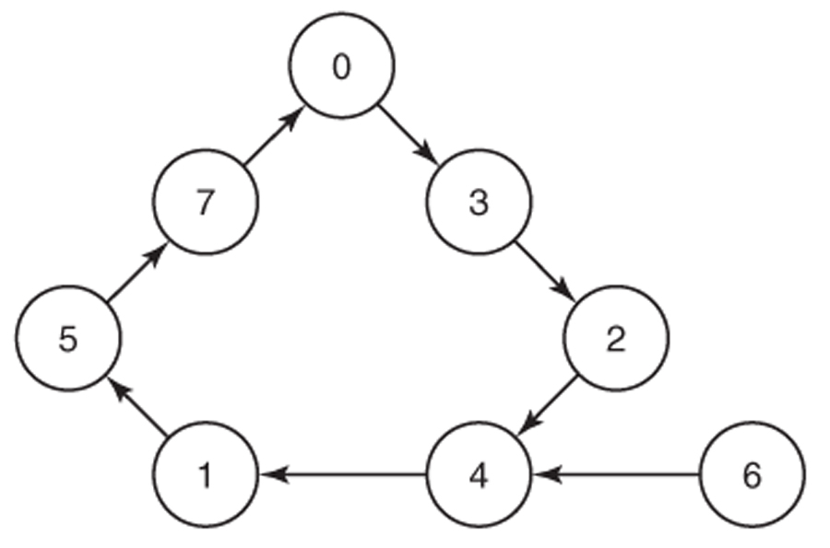

Slide 29
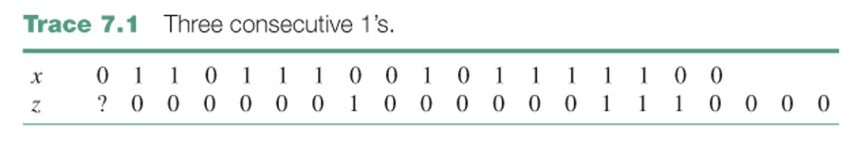
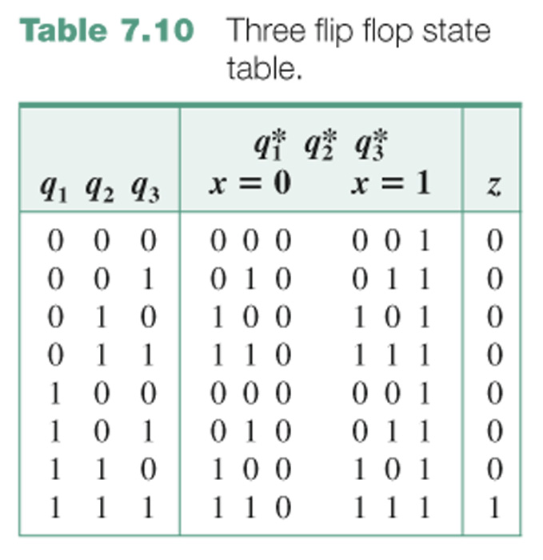
CE6. A system with one input x and one output z such that z = 1 iff x has been 1 for at least three consecutive clock times.

Slide 30
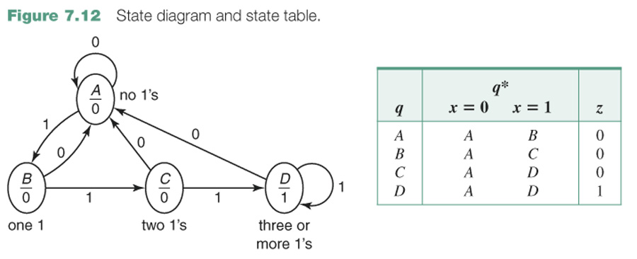
A none, that is, the last input was 0
B one
C two
D three or more

Slide 31
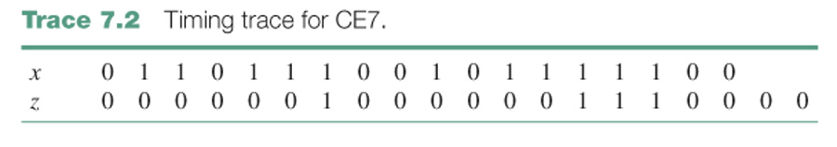
CE7. A system with one input x and one output z such that z = 1 at a clock time iff x is currently 1 and was also 1 at the previous two clock times.
CE7#. A Mealy system with one input x and one output z such that z = 1 iff x has been 1 for three consecutive clock times.

Slide 32
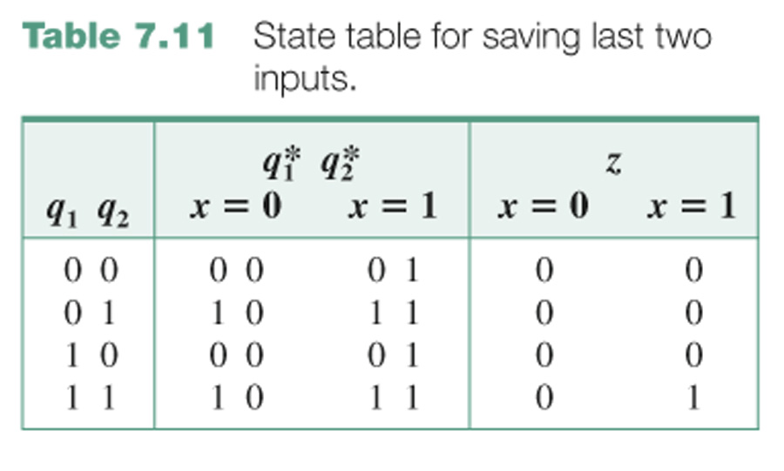

Slide 33
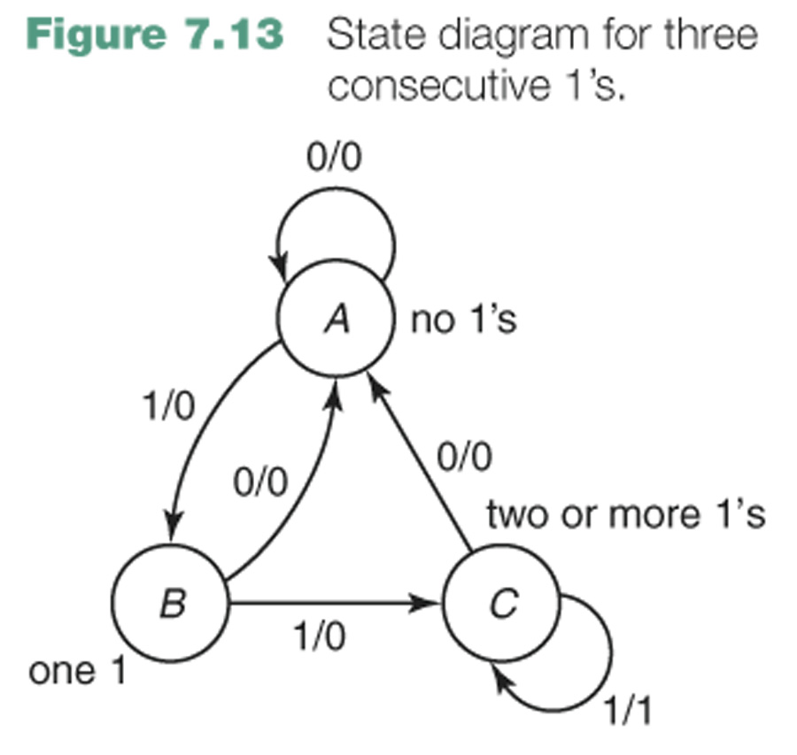
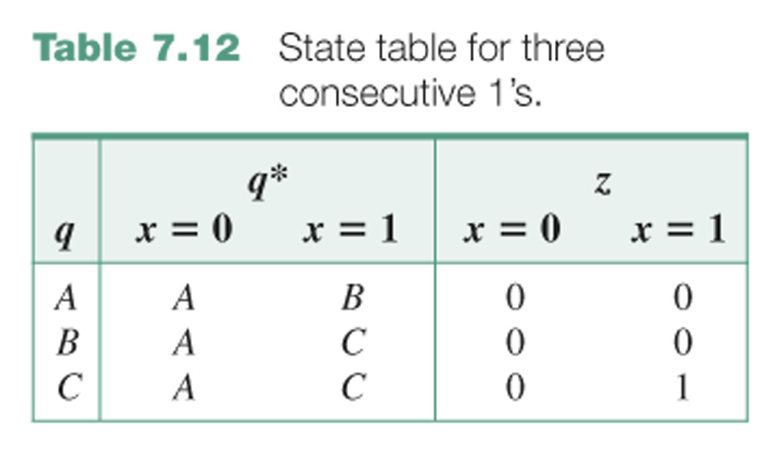
A none, that is, the last input was 0
B one
C two or more

Slide 34
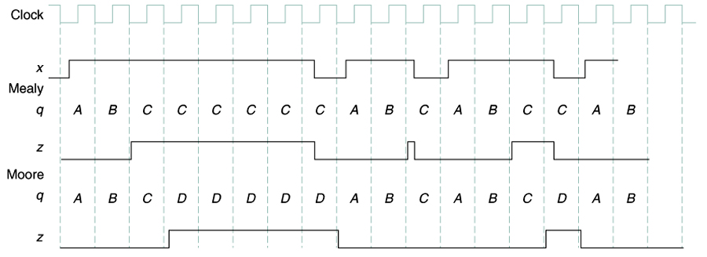

Slide 35
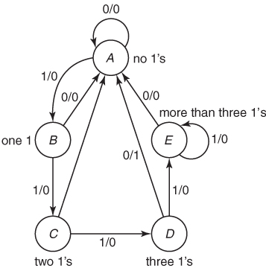
Design a Mealy system with one input x and one output z such that z = 1 iff
x has been 1 for exactly three consecutive clock times.
A sample input/output trace for such a system is
x 0 1 1 1 1 1 1 1 0 1 1 0 1 1 1 0 1
z 0 0 0 0 0 0 0 0 0 0 0 0 0 0 0 1 0 0 0
↑ ↑
A none, that is, the last input was 0
B one 1 in a row
C two 1’s in a row
D three 1’s in a row
E too many (more than 3) 1’s in a row

Slide 36
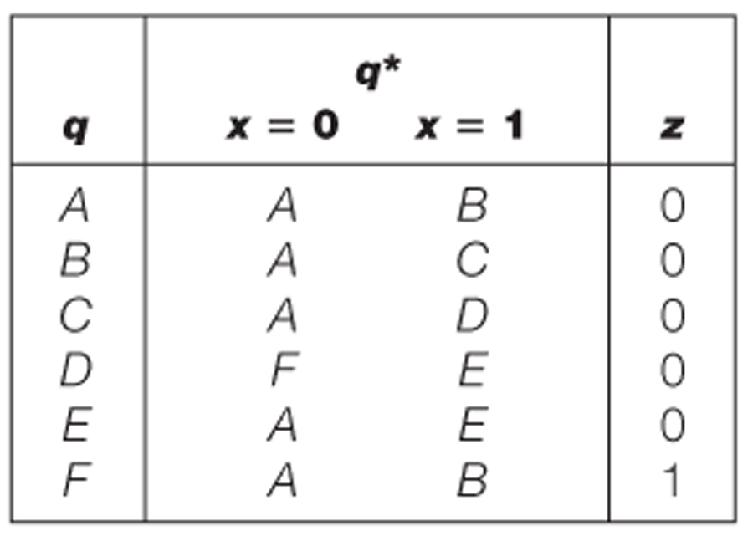
Design a Moore system with one input, x, and one output z such that z = 1 iff
x has been 1 for exactly three consecutive clock times.
x 0 1 1 1 1 1 1 1 0 1 1 0 1 1 1 0 1
z 0 0 0 0 0 0 0 0 0 0 0 0 0 0 0 0 1 0 0 0

Slide 37
